Slide 1
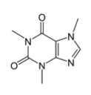
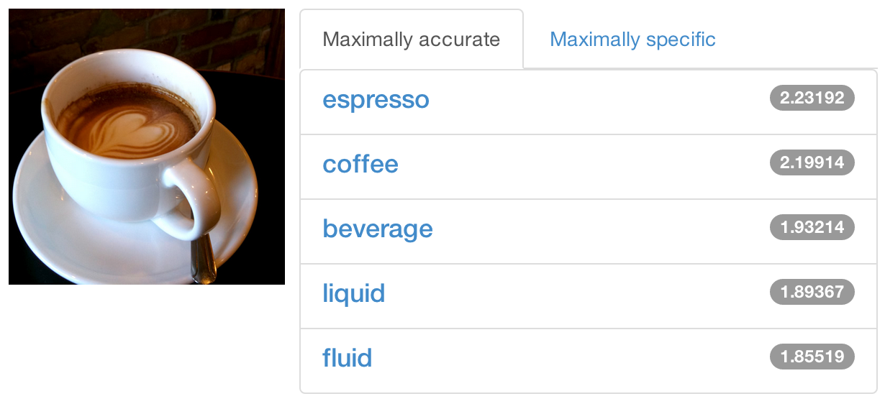



DIY Deep Learning for Vision:
a Hands-On Tutorial with Caffe
caffe.berkeleyvision.org
Evan Shelhamer, Jeff Donahue, Yangqing Jia, Ross Girshick
github.com/BVLC/caffe
Look for further details in the outline notes
Notes:
Outline notes coming soon.

Slide 2
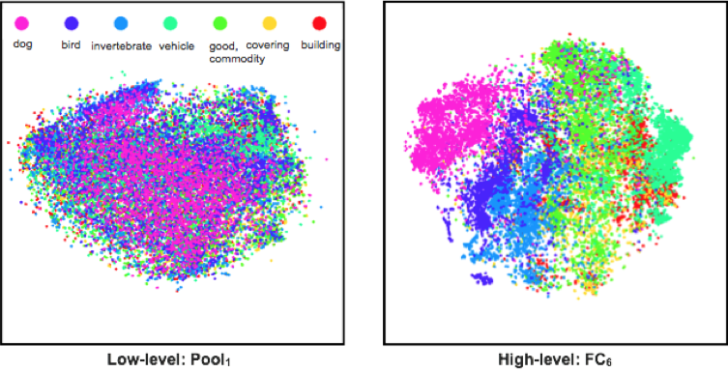
Why Deep Learning? The Unreasonable Effectiveness of Deep Features
Classes separate in the deep representations and transfer to many tasks. [DeCAF] [Zeiler-Fergus]

Slide 3
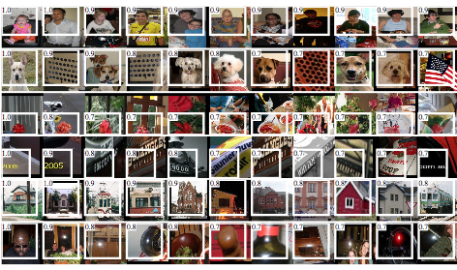
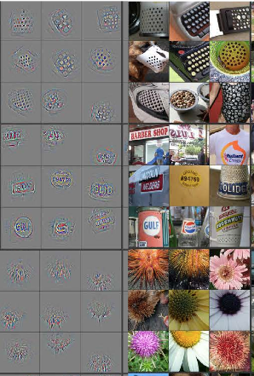
Why Deep Learning? The Unreasonable Effectiveness of Deep Features
Maximal activations of pool₅ units
[R-CNN]
conv₅ DeConv visualization
Rich visual structure of features deep in hierarchy.
[Zeiler-Fergus]

Slide 4
What is Deep Learning?
Compositional Models
Learned End-to-End

Slide 5
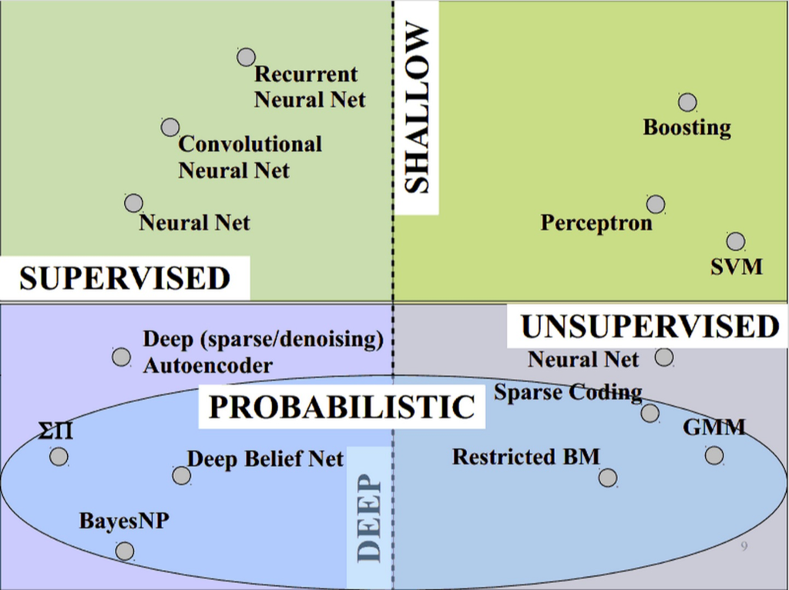
What is Deep Learning?
Vast space of models!
Caffe models are loss-driven:
supervised
unsupervised
slide credit Marc’aurelio Ranzato, CVPR ‘14 tutorial.

Slide 6
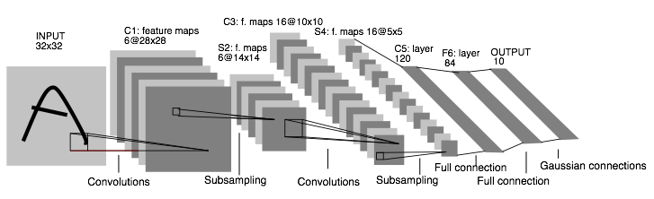
Convolutional Neural Nets (CNNs): 1989
LeNet: a layered model composed of convolution and subsampling operations followed by a holistic representation and ultimately a classifier for handwritten digits. [ LeNet ]

Slide 7
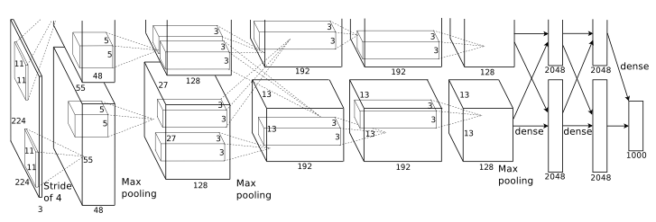
Convolutional Nets: 2012
AlexNet: a layered model composed of convolution, subsampling, and further operations followed by a holistic representation and all-in-all a landmark classifier on
ILSVRC12. [ AlexNet ]
+ data
+ gpu
+ non-saturating nonlinearity
+ regularization

Slide 8
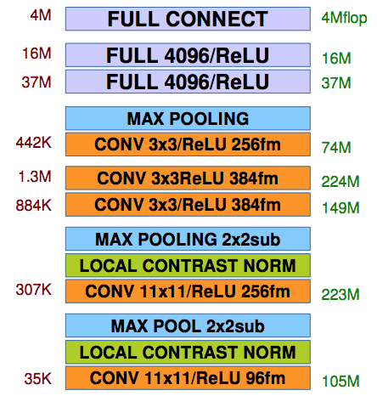
Convolutional Nets: 2012
AlexNet: a layered model composed of convolution, pooling, and further operations followed by a holistic representation and all-in-all a landmark classifier on
ILSVRC12. [ AlexNet ]
The fully-connected “FULL” layers are linear classifiers / matrix multiplications. ReLU are rectified-linear non-linearities on the output of layers.
parameters
FLOPs
figure credit Y. LeCun and M.A. Ranzato, ICML ‘13 tutorial

Slide 9
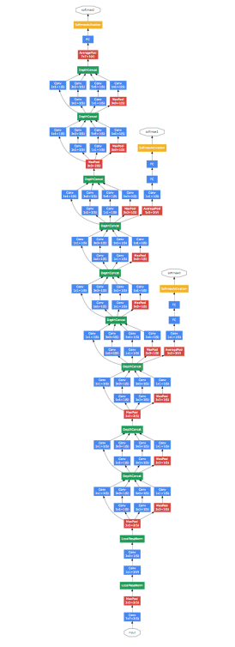
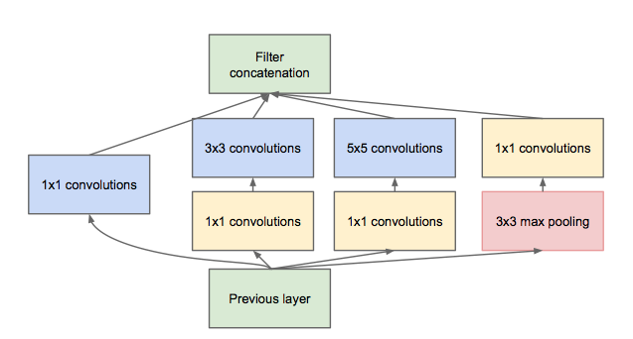
Convolutional Nets: 2014
ILSVRC14 Winners: ~6.6% Top-5 error
GoogLeNet: composition of multi-scale dimension-reduced modules (pictured)
VGG: 16 layers of 3x3 convolution interleaved with max pooling + 3 fully-connected layers
+ depth
+ data
+ dimensionality reduction

Slide 10
Learning about Deep Learning
Refer to the Tutorial on Deep Learning for Vision
from CVPR ‘14.
Fundamentals on supervised and unsupervised deep learning by Marc’Aurelio Ranzato
List of references to explore
Advanced ideas and current research directions
Pairs well with this tutorial!

Slide 11
Frameworks
Torch7
NYU
scientific computing framework in Lua
supported by Facebook
Theano/Pylearn2
U. Montreal
scientific computing framework in Python
symbolic computation and automatic differentiation
Cuda-Convnet2
Alex Krizhevsky
Very fast on state-of-the-art GPUs with Multi-GPU parallelism
C++ / CUDA library

Slide 12
Framework Comparison
More alike than different
All express deep models
All are nicely open-source
All include scripting for hacking and prototyping
No strict winners – experiment and choose the framework that best fits your work
We like to brew our deep networks with Caffe

Slide 13
Why Caffe? In one sip…
Expression: models + optimizations are plaintext schemas, not code.
Speed: for state-of-the-art models and massive data.
Modularity: to extend to new tasks and settings.
Openness: common code and reference models for reproducibility.
Community: joint discussion and development through BSD-2 licensing.

Slide 14

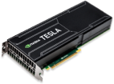
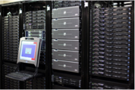
So what is Caffe?
Pure C++ / CUDA architecture for deep learning
command line, Python, MATLAB interfaces
Fast, well-tested code
Tools, reference models, demos, and recipes
Seamless switch between CPU and GPU
Caffe::set_mode(Caffe::GPU);
Prototype
Training
Deployment
All with essentially the same code!

Slide 15
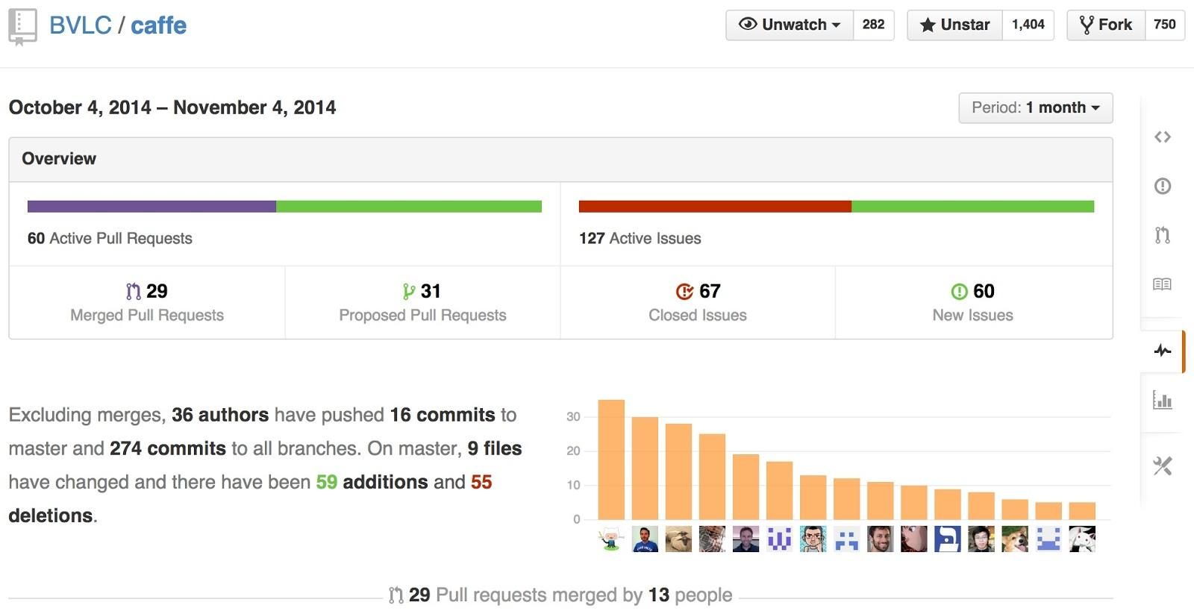
Caffe is a Community project pulse

Slide 16
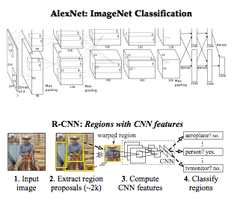
Reference Models
Caffe offers the
model definitions
optimization settings
pre-trained weights
so you can start right away.

Slide 17
Open Model Collection
The Caffe Model Zoo
- open collection of deep models to share innovation
- VGG ILSVRC14 + Devil models in the zoo
- Network-in-Network / CCCP model in the zoo
- MIT Places scene recognition model in the zoo
- help disseminate and reproduce research
- bundled tools for loading and publishing models
Share Your Models! with your citation + license of course

Slide 18
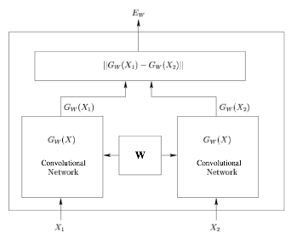
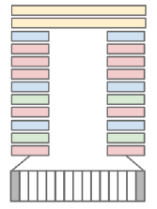
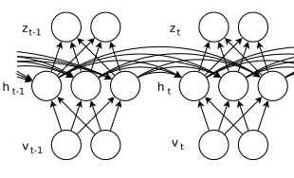
Architectures
DAGs
multi-input
multi-task
Weight Sharing
Recurrent (RNNs)
Sequences
Siamese Nets
Distances
[ Karpathy14 ]
[ Sutskever13 ]
[ Chopra05 ]
Define your own model from our catalogue of layers types and start learning.

Slide 19
Brewing by the Numbers...
Speed with Krizhevsky's 2012 model:
K40 / Titan: 2 ms / image, K20: 2.6ms
Caffe + cuDNN: 1.17ms / image on K40
60 million images / day
8-core CPU: ~20 ms/image
~ 9K lines of C/C++ code
with unit tests ~20k
* Not counting I/O time. Details at http://caffe.berkeleyvision.org/performance_hardware.html

Slide 20
CAFFE INTRO

Slide 21
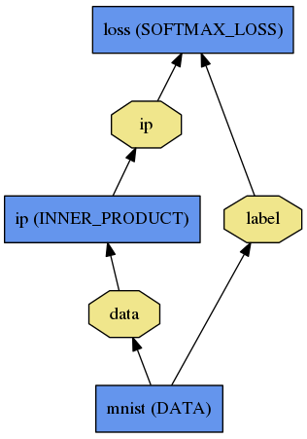
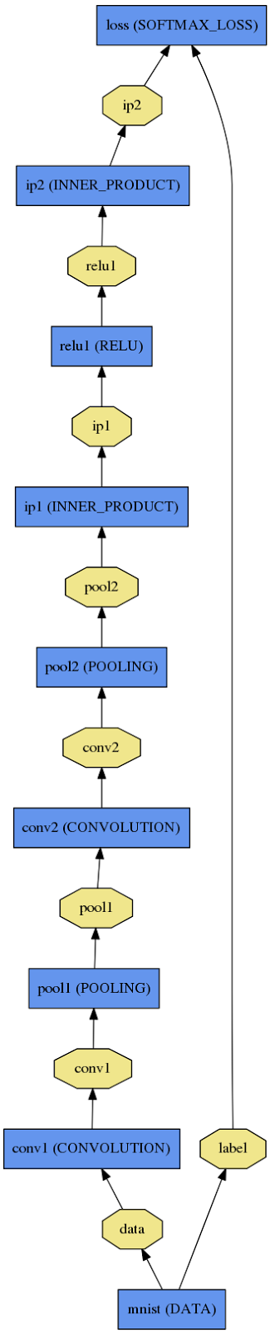
Net
A network is a set of layers connected as a DAG:
name: "dummy-net"
layers { name: "data" …}
layers { name: "conv" …}
layers { name: "pool" …}
… more layers …
layers { name: "loss" …}
LogReg ↑
Caffe creates and checks the net from the definition.
Data and derivatives flow through the net as blobs – a an array interface
LeNet →
ImageNet, Krizhevsky 2012 →

Slide 22
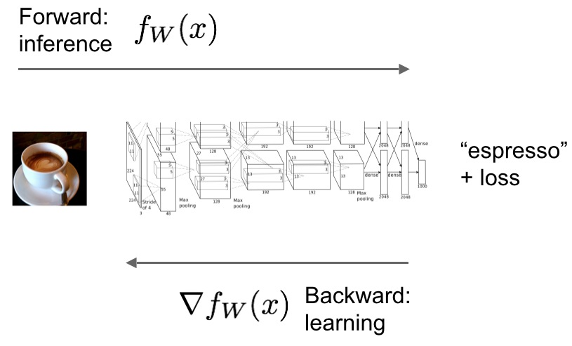
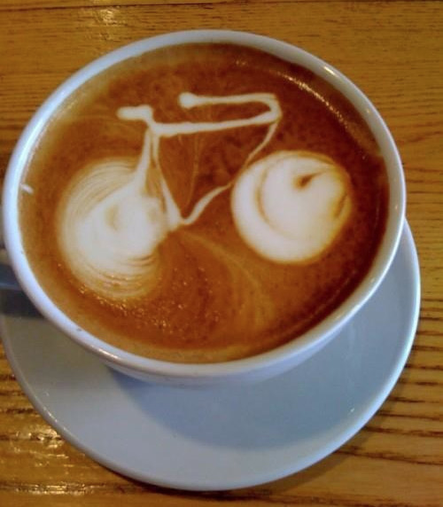
Forward / Backward the essential Net computations
Caffe models are complete machine learning systems for inference and learning.
The computation follows from the model definition. Define the model and run.

Slide 23
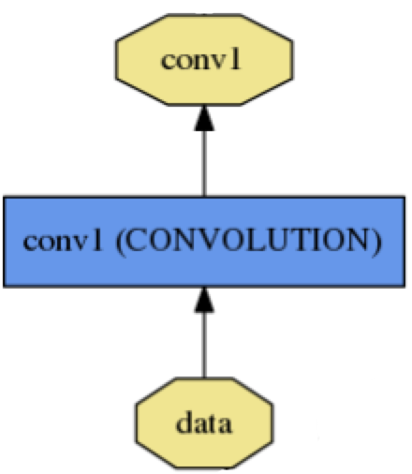
Layer
name: "conv1"
type: CONVOLUTION
bottom: "data"
top: "conv1"
convolution_param {
num_output: 20
kernel_size: 5
stride: 1
weight_filler {
type: "xavier"
}
}
name, type, and the connection structure
(input blobs and output blobs)
layer-specific parameters
- Setup
- Forward
- Backward
Every layer type defines
* Nets + Layers are defined by protobuf schema

Slide 24
Layer Protocol
Setup: run once for initialization.
Forward: make output given input.
Backward: make gradient of output
- w.r.t. bottom
- w.r.t. parameters (if needed)
Model Composition The Net forward and backward passes are the composition the layers’.
Layer Development Checklist

Slide 25
Blob
name: "conv1"
type: CONVOLUTION
bottom: "data"
top: "conv1"
… definition …
Blobs are 4-D arrays for storing and communicating information.
hold data, derivatives, and parameters
lazily allocate memory
shuttle between CPU and GPU
top blob
Data
Number x K Channel x Height x Width
256 x 3 x 227 x 227 for ImageNet train input
Parameter: Convolution Weight
N Output x K Input x Height x Width
96 x 3 x 11 x 11 for CaffeNet conv1
Parameter: Convolution BIas
96 x 1 x 1 x 1 for CaffeNet conv1
bottom blob

Slide 26
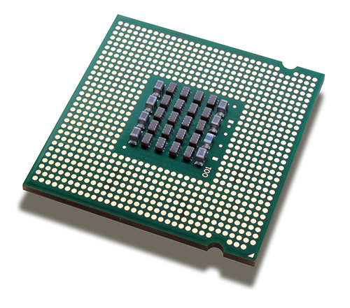
Blob
Blobs provide a unified memory interface.
Reshape(num, channel, height, width)
- declare dimensions
- make SyncedMem -- but only lazily allocate
cpu_data(), mutable_cpu_data()
- host memory for CPU mode
gpu_data(), mutable_gpu_data()
- device memory for GPU mode
SyncedMem
allocation + communication
{cpu,gpu}_diff(), mutable_{cpu,gpu}_diff()
- derivative counterparts to data methods
- easy access to data + diff in forward / backward

Slide 27
Solving: Training a Net
Optimization like model definition is configuration.
train_net: "lenet_train.prototxt"
base_lr: 0.01
momentum: 0.9
weight_decay: 0.0005
max_iter: 10000
snapshot_prefix: "lenet_snapshot"
solver_mode: GPU
All you need to run things on the GPU.
> caffe train -solver lenet_solver.prototxt
Stochastic Gradient Descent (SGD) + momentum ·
Adaptive Gradient (ADAGRAD) · Nesterov’s Accelerated Gradient (NAG)

Slide 28
End to End Recipe...
Convert the data to Caffe-format
lmdb, leveldb, hdf5 / .mat, list of images, etc.
Define the Net
Configure the Solver
caffe train -solver solver.prototxt -gpu 0
Examples are your friends
caffe/examples/mnist,cifar10,imagenet
caffe/build/tools/*

Slide 29
(Examples)
Logistic Regression
Learn LeNet on MNIST

Slide 30
FINE-TUNING

Slide 31
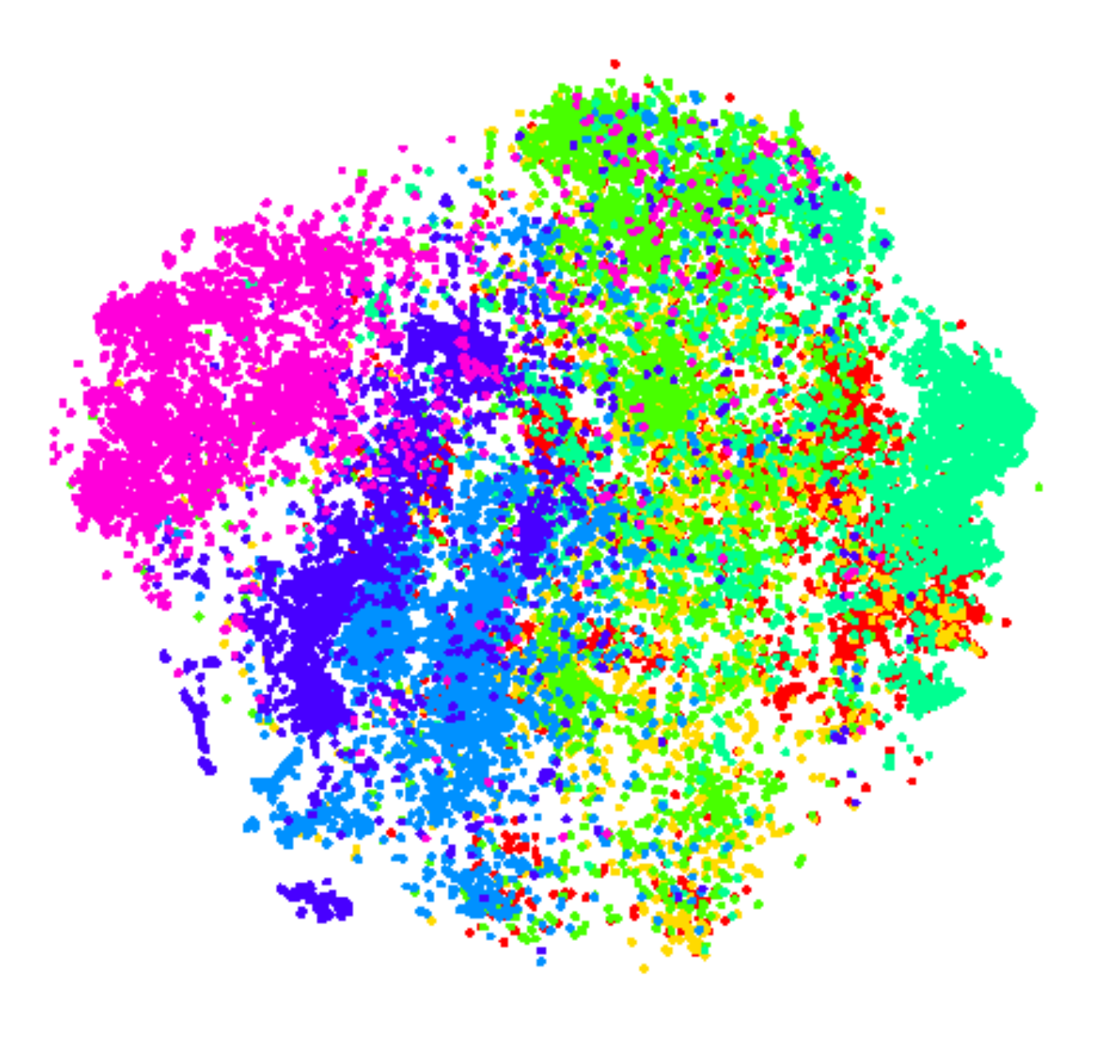
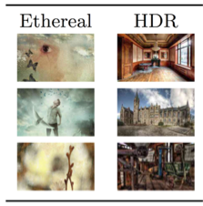
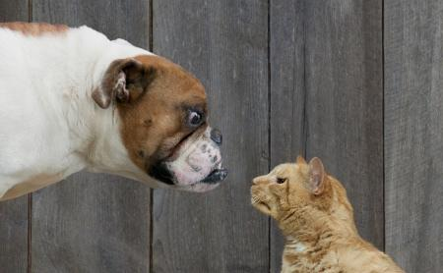
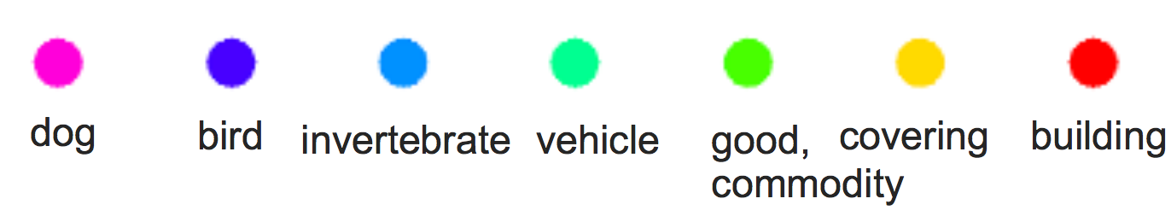
Fine-tuning Transferring learned weights to kick-start models
Take a pre-trained model and fine-tune to new tasks [DeCAF] [Zeiler-Fergus] [OverFeat]
Style
Recognition
Dogs vs.
Cats
top 10 in 10 minutes
Your Task
© kaggle.com

Slide 32
From ImageNet to Style
Simply change a few lines in the layer definition
layers { name: "data" type: DATA
data_param {
source: "ilsvrc12_train_leveldb"
mean_file: "../../data/ilsvrc12"
...
}
...
}
...
layers { name: "fc8" type: INNER_PRODUCT blobs_lr: 1 blobs_lr: 2
weight_decay: 1 weight_decay: 0
inner_product_param {
num_output: 1000
...
}
}
layers { name: "data" type: DATA
data_param {
source: "style_leveldb"
mean_file: "../../data/ilsvrc12"
...
}
...
}
...
layers { name: "fc8-style" type: INNER_PRODUCT blobs_lr: 1 blobs_lr: 2
weight_decay: 1 weight_decay: 0
inner_product_param {
num_output: 20
...
}
}
Input:
A different source
new name = new params
Last Layer:
A different classifier

Slide 33
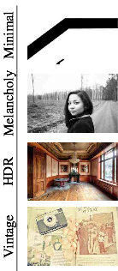
From ImageNet to Style
> caffe train -solver models/finetune_flickr_style/solver.prototxt
-weights bvlc_reference_caffenet.caffemodel
Under the hood (loosely speaking):
net = new Caffe::Net( "style_solver.prototxt");
net.CopyTrainedNetFrom(
pretrained_model);
solver.Solve(net);

Slide 34
(Example)
Fine-tuning from ImageNet to Style

Slide 35
LOSS

Slide 36
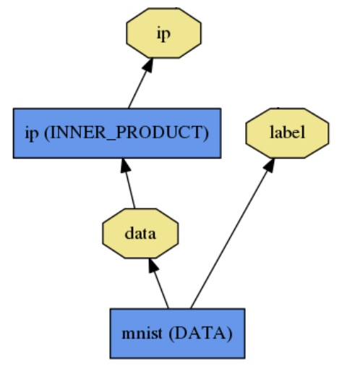
Loss
What kind of model is this?

Slide 37
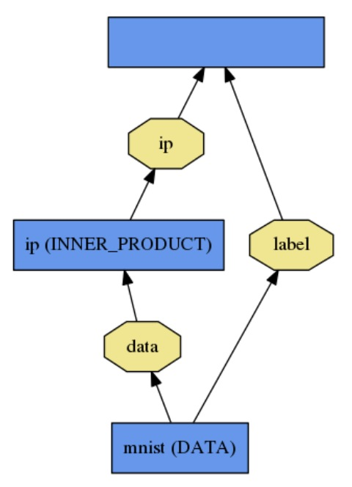
Loss
loss (LOSS_TYPE)
Classification
SOFTMAX_LOSS
HINGE_LOSS
Linear Regression
EUCLIDEAN_LOSS
Attributes / Multiclassification
SIGMOID_CROSS_ENTROPY_LOSS
Others…
New Task
NEW_LOSS
What kind of model is this?
Who knows! Need a loss function.

Slide 38
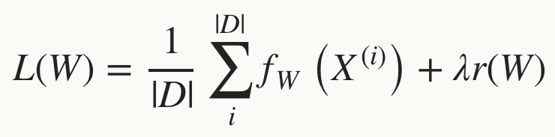
Loss
Loss function determines the learning task.
Given data D, a Net typically minimizes:
Data term: error averaged over instances
Regularization term: penalize large weights to improve generalization

Slide 39
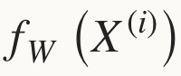
Loss
The data error term is computed by Net::Forward
Loss is computed as the output of Layers
Pick the loss to suit the task – many different losses for different needs

Slide 40
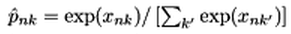
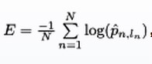
Softmax Loss Layer
Multinomial logistic regression: used for predicting a single class of K mutually exclusive classes
layers { name: "loss" type: SOFTMAX_LOSS bottom: "pred" bottom: "label" top: "loss" }

Slide 41
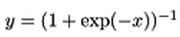
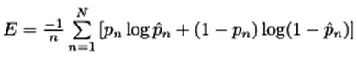
Sigmoid Cross-Entropy Loss
Binary logistic regression: used for predicting K independent probability values in [0, 1]
layers { name: "loss" type: SIGMOID_CROSS_ENTROPY_LOSS bottom: "pred" bottom: "label" top: "loss" }

Slide 42
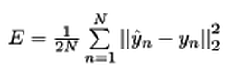
Euclidean Loss
A loss for regressing to real-valued labels [-inf, inf]
layers { name: "loss" type: EUCLIDEAN_LOSS bottom: "pred" bottom: "label" top: "loss" }

Slide 43
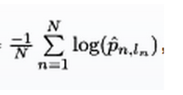
Multiple loss layers
Your network can contain as many loss functions as you want
Reconstruction and Classification:
layers { name: "recon-loss" type: EUCLIDEAN_LOSS bottom: "reconstructions" bottom: "data" top: "recon-loss" }
layers { name: "class-loss" type: SOFTMAX_LOSS bottom: "class-preds" bottom: "class-labels" top: "class-loss" }

Slide 44
Multiple loss layers
“*_LOSS” layers have a default loss weight of 1
layers { name: "loss" type: SOFTMAX_LOSS bottom: "pred" bottom: "label" top: "loss" }
layers { name: "loss" type: SOFTMAX_LOSS bottom: "pred" bottom: "label" top: "loss" loss_weight: 1.0 }
==

Slide 45
Multiple loss layers
Give each loss its own weight
E.g. give higher priority to classification error
layers { name: "recon-loss" type: EUCLIDEAN_LOSS bottom: "reconstructions" bottom: "data" top: "recon-loss" }
layers { name: "class-loss" type: SOFTMAX_LOSS bottom: "class-preds" bottom: "class-labels" top: "class-loss" loss_weight: 100.0 }
100*

Slide 46
Any layer can produce a loss!
Just add loss_weight: 1.0 to have a layer’s output be incorporated into the loss
E = || pred - label ||^2 / (2N)
diff = pred - label
layers { name: "loss" type: POWER bottom: "diff" top: "euclidean_loss"
power_param {
power: 2
}
# = 1/(2N)
loss_weight: 0.0078125 }
E = || diff ||^2 / (2N)
layers { name: "diff" type: ELTWISE bottom: "pred" bottom: "label" top: "diff"
eltwise_param {
op: SUM
coeff: 1
coeff: -1
}
}
layers { name: "loss" type: EUCLIDEAN_LOSS bottom: "pred" bottom: "label" top: "euclidean_loss"
loss_weight: 1.0 }
==
+

Slide 47
SOLVER

Slide 48
Solver
Solver optimizes the network weights W to minimize the loss L(W) over the data D
Coordinates forward / backward, weight updates, and scoring.

Slide 49
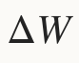
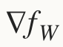
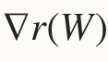
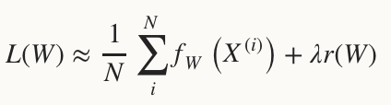
Solver
Computes parameter update , formed from
The stochastic error gradient
The regularization gradient
Particulars to each solving method

Slide 50
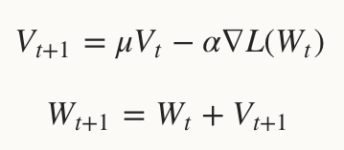
SGD Solver
Stochastic gradient descent, with momentum
solver_type: SGD

Slide 51
SGD Solver
“AlexNet” [1] training strategy:
Use momentum 0.9
Initialize learning rate at 0.01
Periodically drop learning rate by a factor of 10
Just a few lines of Caffe solver specification:
base_lr: 0.01 lr_policy: "step"
gamma: 0.1 stepsize: 100000 max_iter: 350000
momentum: 0.9
[1] A. Krizhevsky, I. Sutskever, and G. Hinton. ImageNet Classification with Deep Convolutional Neural Networks. Advances in Neural Information Processing Systems, 2012.

Slide 52
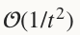
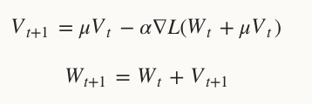
NAG Solver
Nesterov’s accelerated gradient [1]
solver_type: NESTEROV
Proven to have optimal convergence rate for convex problems
[1] Y. Nesterov. A Method of Solving a Convex Programming Problem with Convergence Rate (1/sqrt(k)). Soviet Mathematics Doklady, 1983.

Slide 53
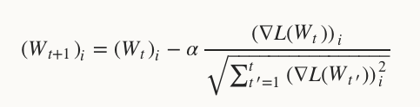
AdaGrad Solver
Adaptive gradient (Duchi et al. [1])
solver_type: ADAGRAD
Attempts to automatically scale gradients based on historical gradients
[1] J. Duchi, E. Hazan, and Y. Singer. Adaptive Subgradient Methods for Online Learning and Stochastic Optimization. The Journal of Machine Learning Research, 2011.

Slide 54
Solver Showdown: MNIST Autoencoder
AdaGrad
SGD
Nesterov
I0901 13:36:30.007884 24952 solver.cpp:232] Iteration 65000, loss = 64.1627 I0901 13:36:30.007922 24952 solver.cpp:251] Iteration 65000, Testing net (#0) # train set I0901 13:36:33.019305 24952 solver.cpp:289] Test loss: 63.217 I0901 13:36:33.019356 24952 solver.cpp:302] Test net output #0: cross_entropy_loss = 63.217 (* 1 = 63.217 loss) I0901 13:36:33.019773 24952 solver.cpp:302] Test net output #1: l2_error = 2.40951
I0901 13:35:20.426187 20072 solver.cpp:232] Iteration 65000, loss = 61.5498 I0901 13:35:20.426218 20072 solver.cpp:251] Iteration 65000, Testing net (#0) # train set I0901 13:35:22.780092 20072 solver.cpp:289] Test loss: 60.8301 I0901 13:35:22.780138 20072 solver.cpp:302] Test net output #0: cross_entropy_loss = 60.8301 (* 1 = 60.8301 loss) I0901 13:35:22.780146 20072 solver.cpp:302] Test net output #1: l2_error = 2.02321
I0901 13:36:52.466069 22488 solver.cpp:232] Iteration 65000, loss = 59.9389 I0901 13:36:52.466099 22488 solver.cpp:251] Iteration 65000, Testing net (#0) # train set I0901 13:36:55.068370 22488 solver.cpp:289] Test loss: 59.3663 I0901 13:36:55.068410 22488 solver.cpp:302] Test net output #0: cross_entropy_loss = 59.3663 (* 1 = 59.3663 loss) I0901 13:36:55.068418 22488 solver.cpp:302] Test net output #1: l2_error = 1.79998

Slide 55
DAG

Slide 56
Nets are DAGs
Modern deep learning approaches to vision have a mostly linear structure
Data
Con-volve
Pool
Rect-ify
...
Con-volve
Pool
Rect-ify
Inner Prod
Pre-
dict
Loss
Label

Slide 57
Nets are DAGs
Modern deep learning approaches to vision have a mostly linear structure
But Caffe nets can have any arbitrary directed acyclic graph (DAG) structure
Data
Con-volve
Pool
Rect-ify
...
Con-volve
Pool
Rect-ify
Inner Prod
Pre-
dict
Loss
Label

Slide 58
Nets are DAGs
Data
Con-volve
Pool
Rect-ify
...
Con-volve
Pool
Rect-ify
Inner Prod
?
?
Sum
Pre-
dict
Loss
?
?
...
?
Label
?
...
?

Slide 59
WEIGHT SHARING

Slide 60
Weight sharing
Parameters can be shared and reused across Layers throughout the Net
Applications:
Convolution at multiple scales / pyramids
Recurrent Neural Networks (RNNs)
Siamese nets for distance learning

Slide 61
Weight sharing
Just give the parameter blobs explicit names using the param field
Layers specifying the same param name will share that parameter, accumulating gradients accordingly
layers: {
name: 'innerproduct1'
type: INNER_PRODUCT
inner_product_param {
num_output: 10
bias_term: false
weight_filler {
type: 'gaussian'
std: 10
}
}
param: 'sharedweights'
bottom: 'data'
top: 'innerproduct1'
}
layers: {
name: 'innerproduct2'
type: INNER_PRODUCT
inner_product_param {
num_output: 10
bias_term: false
}
param: 'sharedweights'
bottom: 'data'
top: 'innerproduct2'
}

Slide 62
EXAMPLES

Slide 63
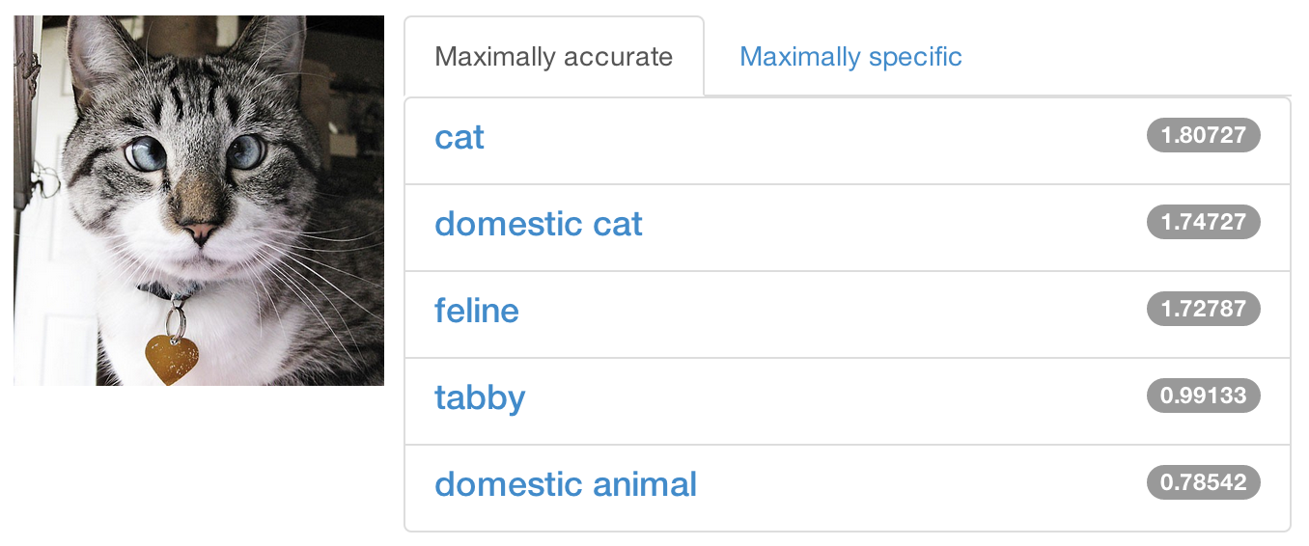
Share a Sip of Brewed Models
demo.caffe.berkeleyvision.org
demo code open-source and bundled

Slide 64
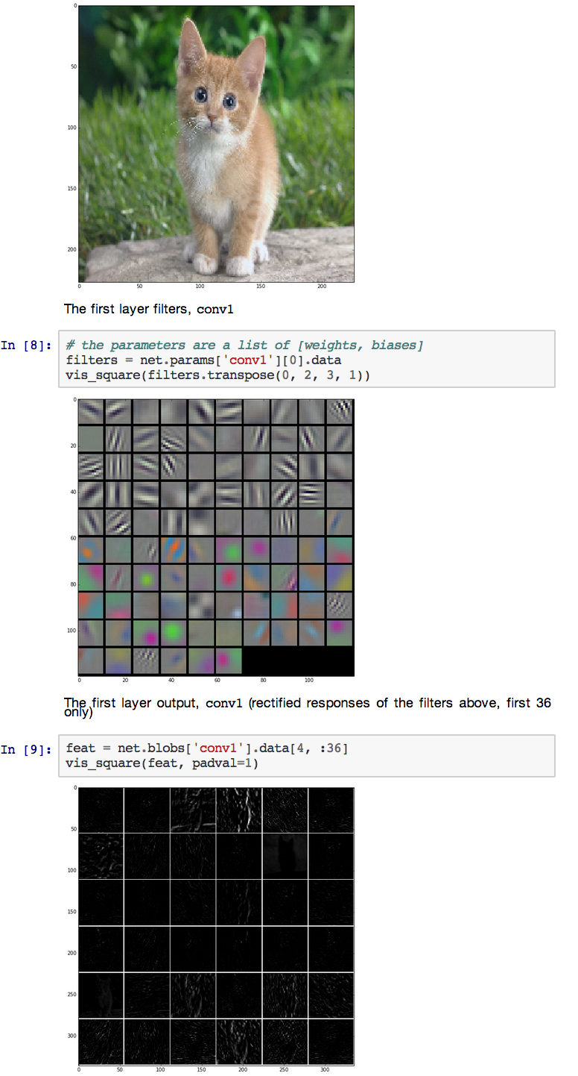
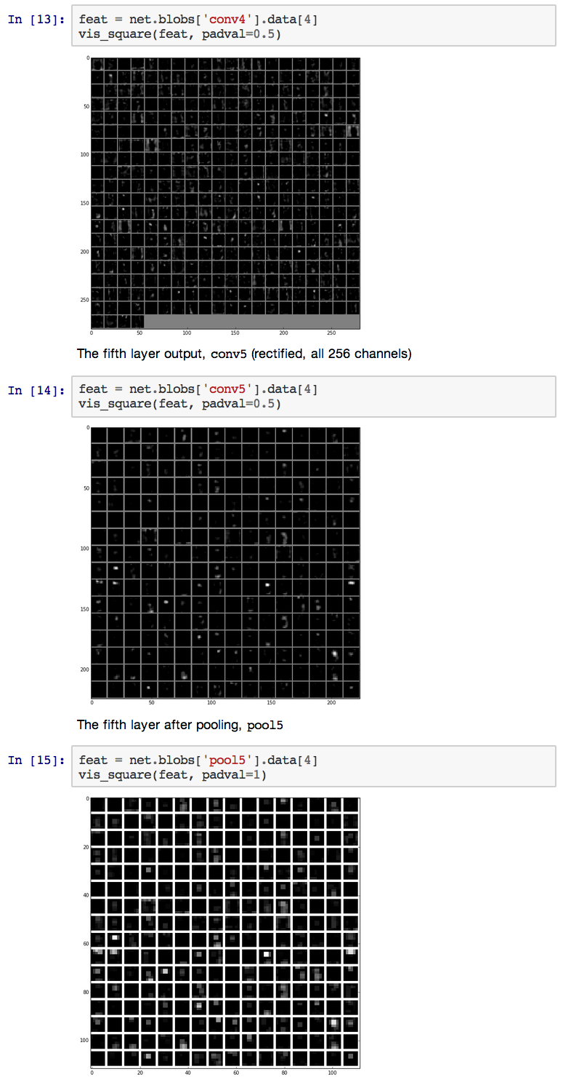


Feature Visualization

Slide 65

Fully Convolutional Models
Transform fixed-input models into any-size models by translating inner products to convolutions.
The computation exploits a natural efficiency of convolutional neural network (CNN) structure by dynamic programming in the forward pass from shallow to deep layers and analogously in backward.
Net surgery in Caffe
how to transform models:
- make fully convolutional
- transplant parameters
[ OverFeat]

Slide 66
RELATED PROJECTS

Slide 67

Object Detection
R-CNN: Regions with Convolutional Neural Networks
http://nbviewer.ipython.org/github/BVLC/caffe/blob/master/examples/detection.ipynb
Full R-CNN scripts available at
https://github.com/rbgirshick/rcnn
Ross Girshick et al.
Rich feature hierarchies for accurate object detection and semantic segmentation. CVPR14.

Slide 68

Visual Style Recognition
Karayev et al. Recognizing Image Style. BMVC14. Caffe fine-tuning example.
Demo online at http://demo.vislab.berkeleyvision.org/ (see Results Explorer).
Other Styles:
Vintage
Long Exposure
Noir
Pastel
Macro
… and so on.
[ Image-Style]

Slide 69
LATEST ROAST
Documentation
- all tutorial materials
- long-form descriptions
- developer API

Slide 70
LATEST ROAST
Caffe + cuDNN
- NVIDIA-Caffe collaboration
- drop-in acceleration library for key computations
- convolution, pooling, nonlinearities, softmax
- 1.2 - 3x layer-wise speedups
- in release candidate edition of master branch now

Slide 71


Slide 72

** not including IO

Slide 73


Slide 74


Slide 75
LATEST ROAST
Parallel Caffe
- parallel / distributed training across CPUs, GPUs, and cluster nodes
- pull request from Flickr by @cypof (thanks!) - promoted to official branch for integration in PR #1148
- join the work-in-progress to help merge

Slide 76
LAST SIP
Caffe...
is fast
is state-of-the-art
has tips, recipes, demos, and models
brings together an active community
...all for free and open source

Slide 77








Thanks to the Caffe crew
Yangqing Jia, Evan Shelhamer, Jeff Donahue, Sergey Karayev
Jonathan Long, Ross Girshick, Sergio Guadarrama
and our open source contributors!
...plus the cold-brew

Slide 78








Acknowledgements
Thank you to the Berkeley Vision and Learning Center Sponsors.
Thank you to NVIDIA
for GPU donation and
collaboration on cuDNN.
Thank you to our 50+
open source contributors
and vibrant community.
Thank you to A9 and AWS
for a research grant for Caffe dev and reproducible research.

Slide 79
References
[ DeCAF ] J. Donahue, Y. Jia, O. Vinyals, J. Hoffman, N. Zhang, E. Tzeng, and T. Darrell. Decaf: A deep convolutional activation feature for generic visual recognition. ICML, 2014.
[ R-CNN ] R. Girshick, J. Donahue, T. Darrell, and J. Malik. Rich feature hierarchies for accurate object detection and semantic segmentation. CVPR, 2014.
[ Zeiler-Fergus ] M. Zeiler and R. Fergus. Visualizing and understanding convolutional networks. ECCV, 2014.
[ LeNet ] Y. LeCun, L. Bottou, Y. Bengio, and P. Haffner. Gradient-based learning applied to document recognition. IEEE, 1998.
[ AlexNet ] A. Krizhevsky, I. Sutskever, and G. Hinton. Imagenet classification with deep convolutional neural networks. NIPS, 2012.
[ OverFeat ] P. Sermanet, D. Eigen, X. Zhang, M. Mathieu, R. Fergus, and Y. LeCun. Overfeat: Integrated recognition, localization and detection using convolutional networks. ICLR, 2014.
[ Image-Style ] S. Karayev, M. Trentacoste, H. Han, A. Agarwala, T. Darrell, A. Hertzmann, H. Winnemoeller. Recognizing Image Style. BMVC, 2014.
[ Karpathy14 ] A. Karpathy, G. Toderici, S. Shetty, T. Leung, R. Sukthankar, and L. Fei-Fei. Large-scale video classification with convolutional neural networks. CVPR, 2014.
[ Sutskever13 ] I. Sutskever. Training Recurrent Neural Networks. PhD thesis, University of Toronto, 2013.
[ Chopra05 ] S. Chopra, R. Hadsell, and Y. LeCun. Learning a similarity metric discriminatively, with application to face verification. CVPR, 2005.

